Slide 1
Data Engineering HW1
Question 1

Slide 2
General Steps
1- get the yml file up and run all images using:
docker-compose up
2- nifi is exist on local port 8080
on your browser open >> localhost:8080/nifi/
3- to upload the template "CsvToJson"
right click on template icon and drag it to the working space
choose "upload template" >>
select the XML file "CsvToJson"
select "CsvToJson" template
drag and drop template >>
select "TEST1" CsvToJson >>
ADD
5- start the workflow from the operate in left side of the window
6- then your CSV (in_nifi folder) will be converted to JSON file in (out_nifi folder)

Slide 3
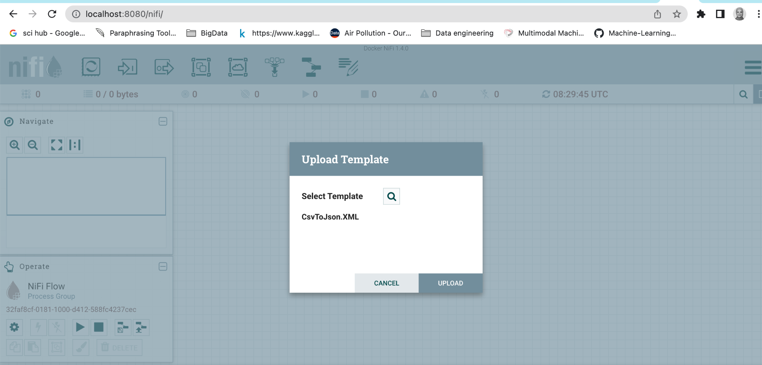

Slide 4
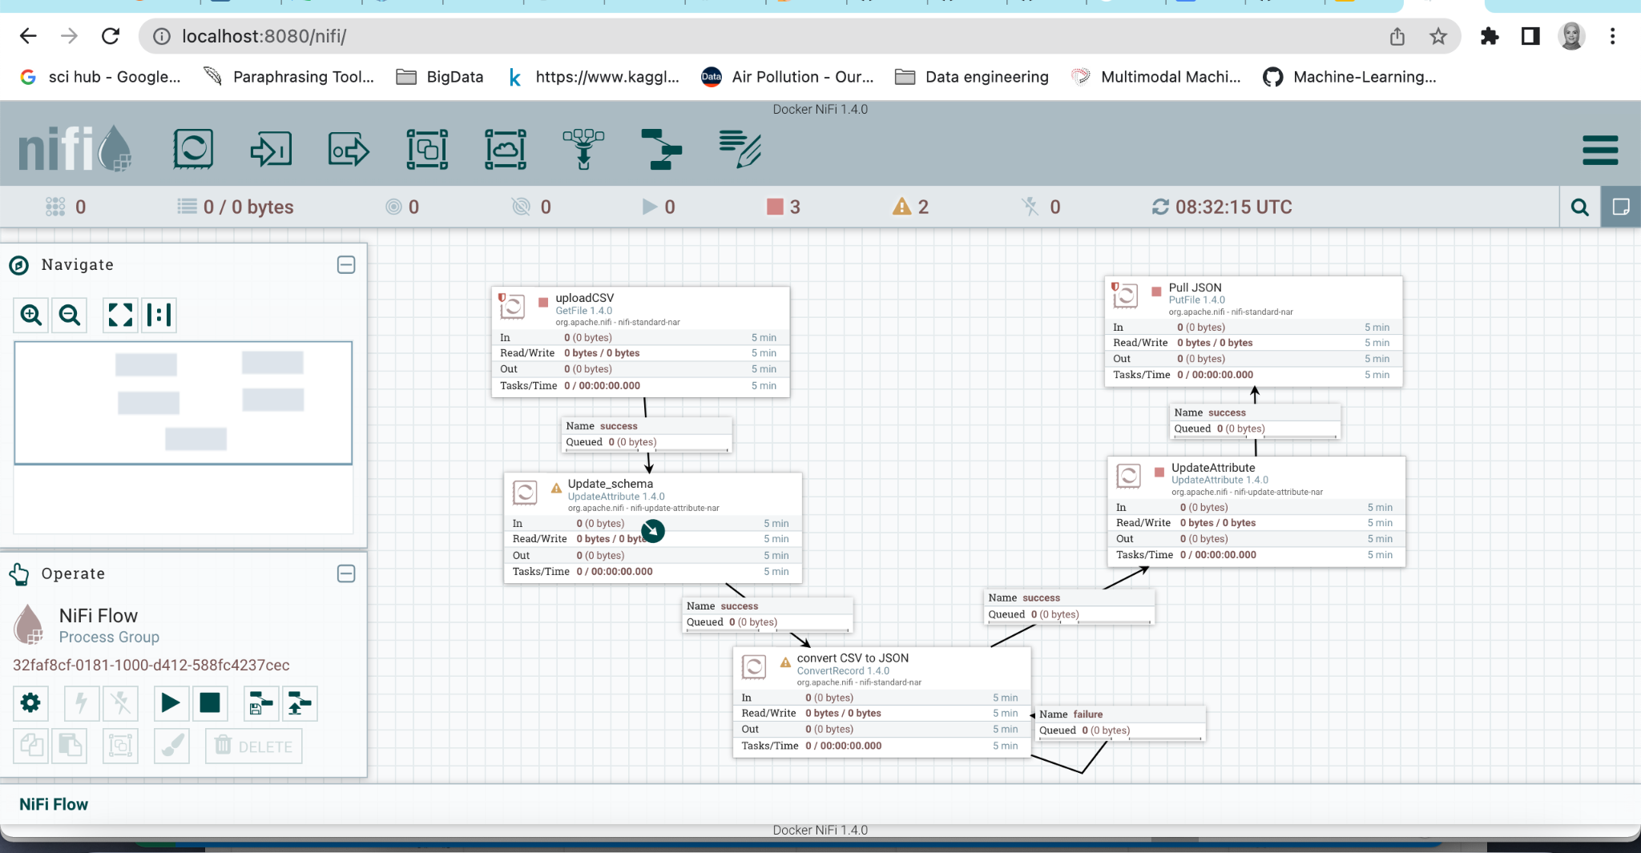
This is the template

Slide 5
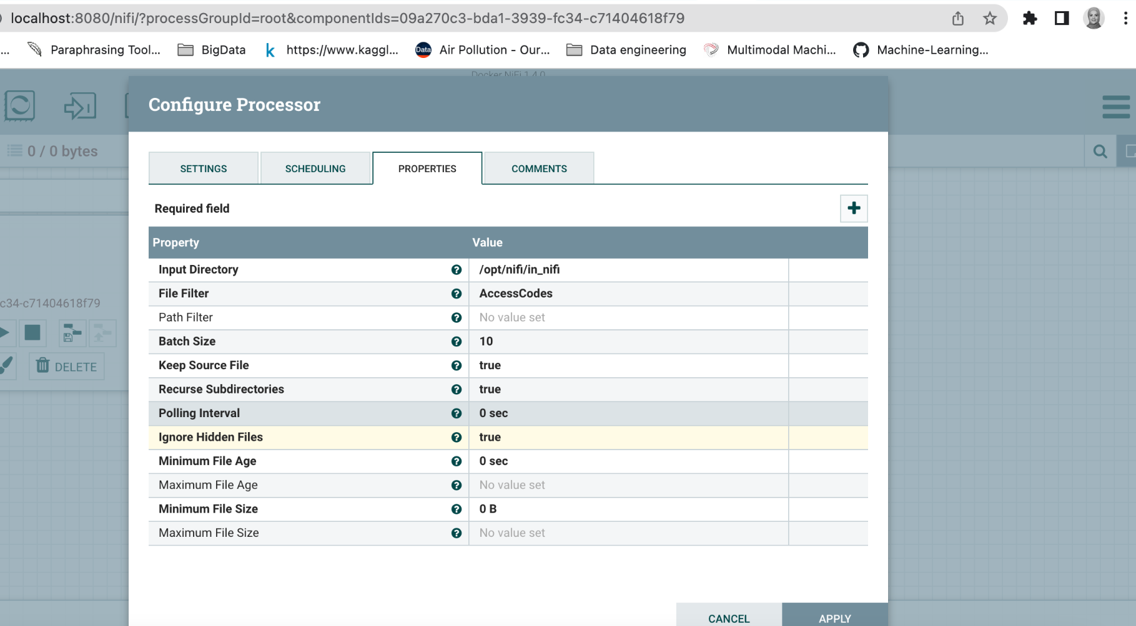
Set the directory of the input file

Slide 6
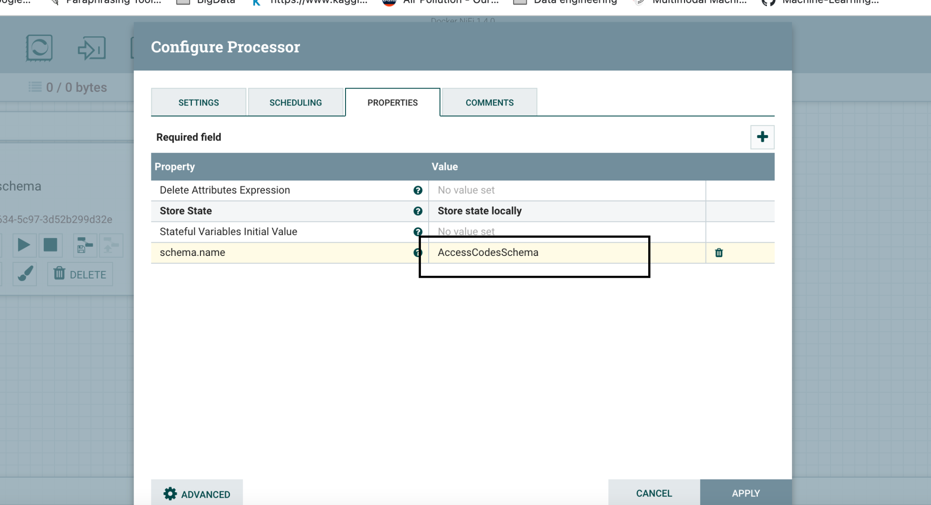
Insert the Schema name

Slide 7
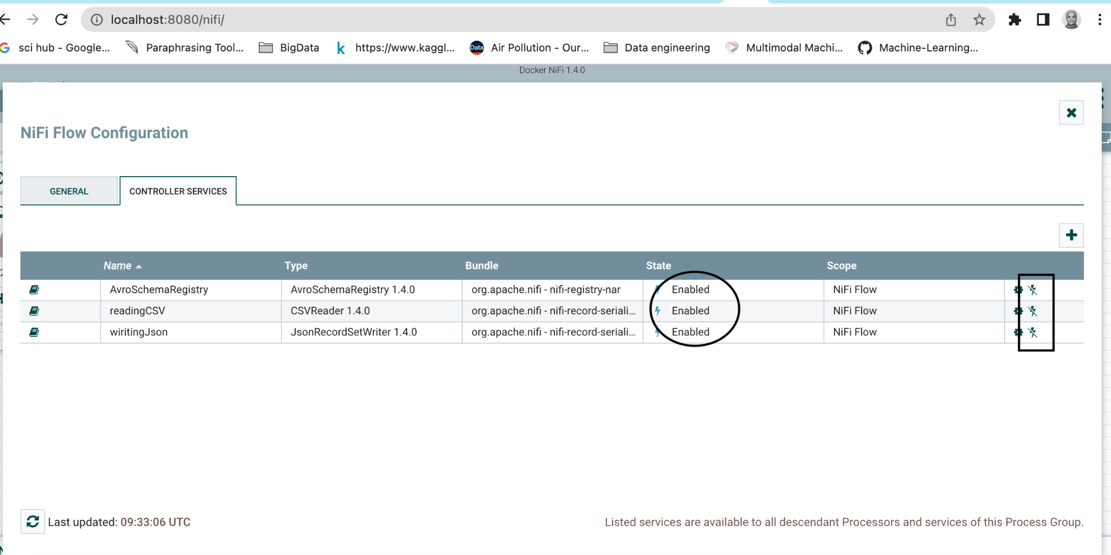
ENable the configuration services

Slide 8
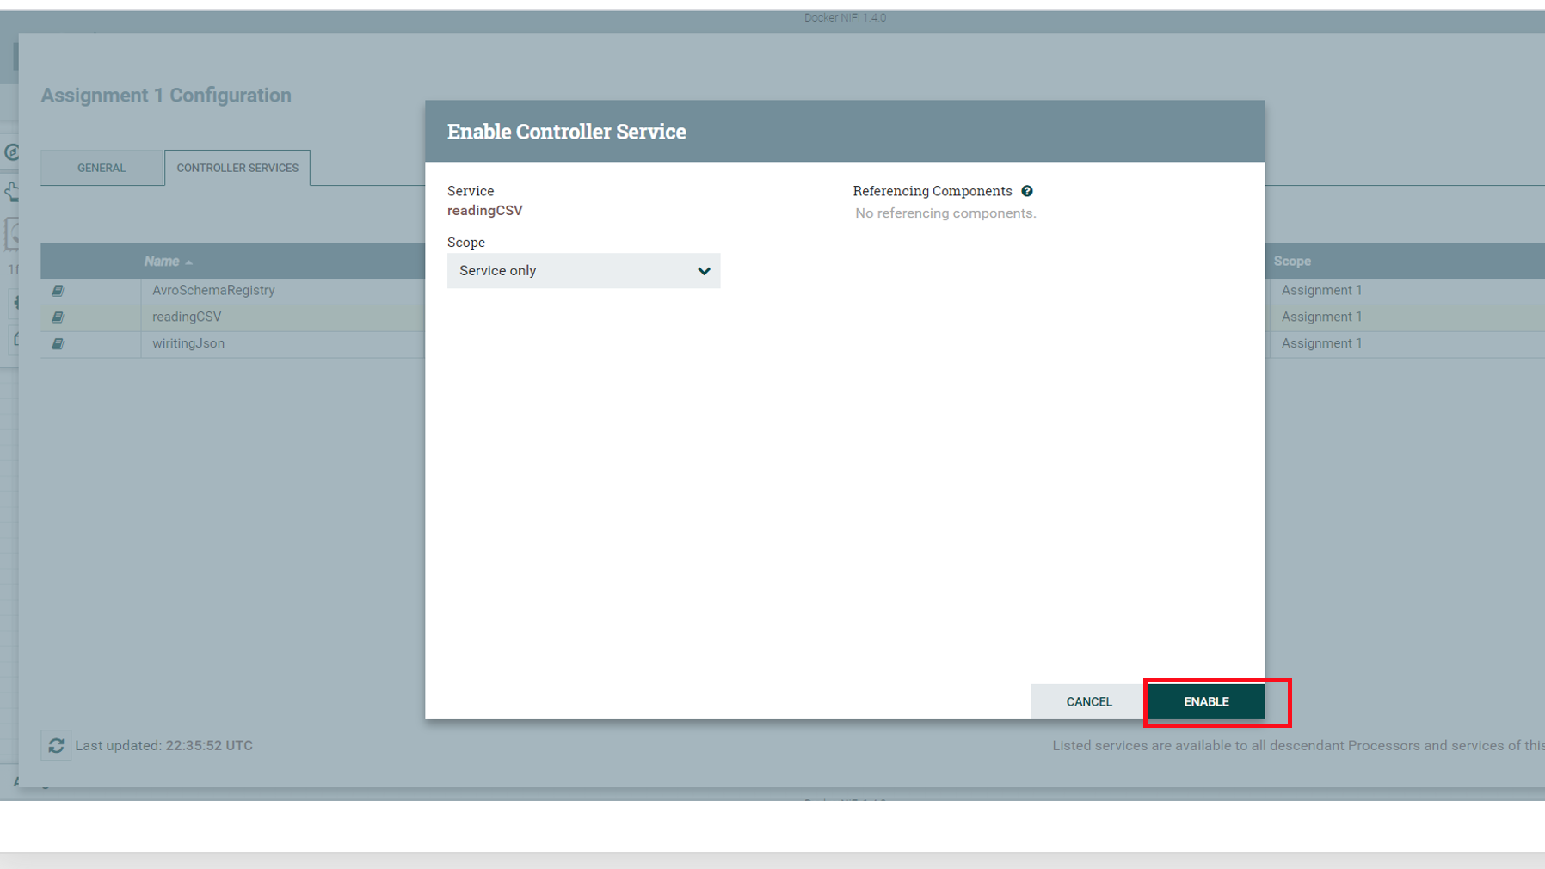

Slide 9
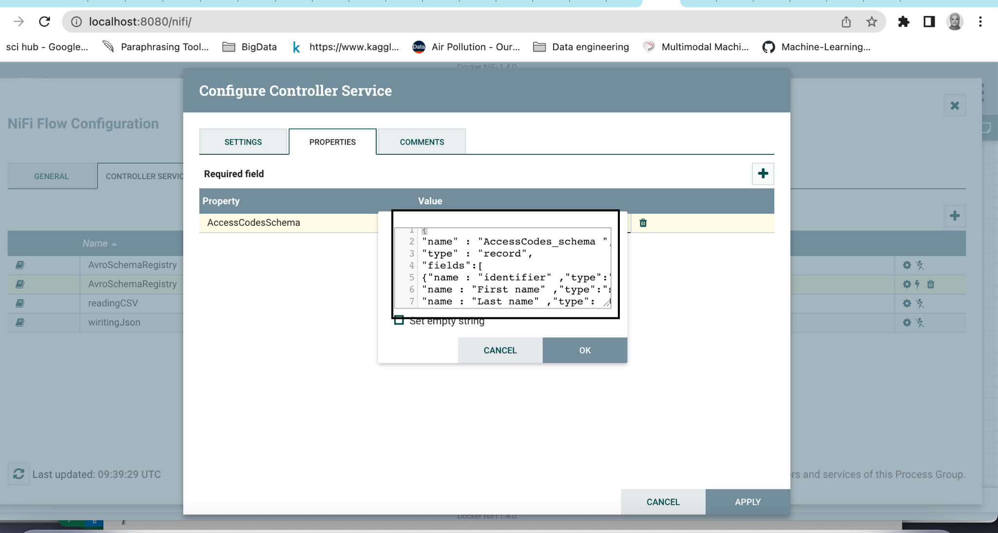
Set the schema of the CSV File

Slide 10
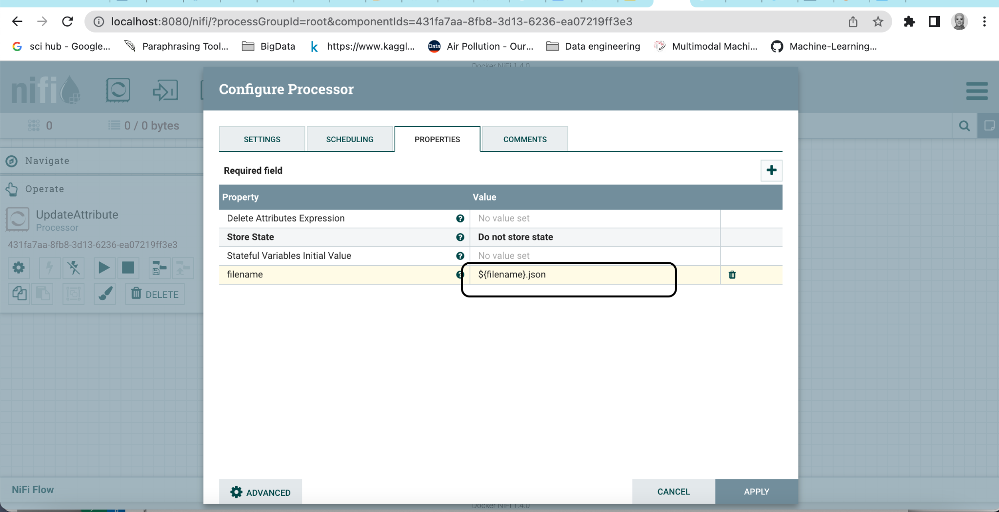
From the update node open setting gear
Update the json configuration

Slide 11
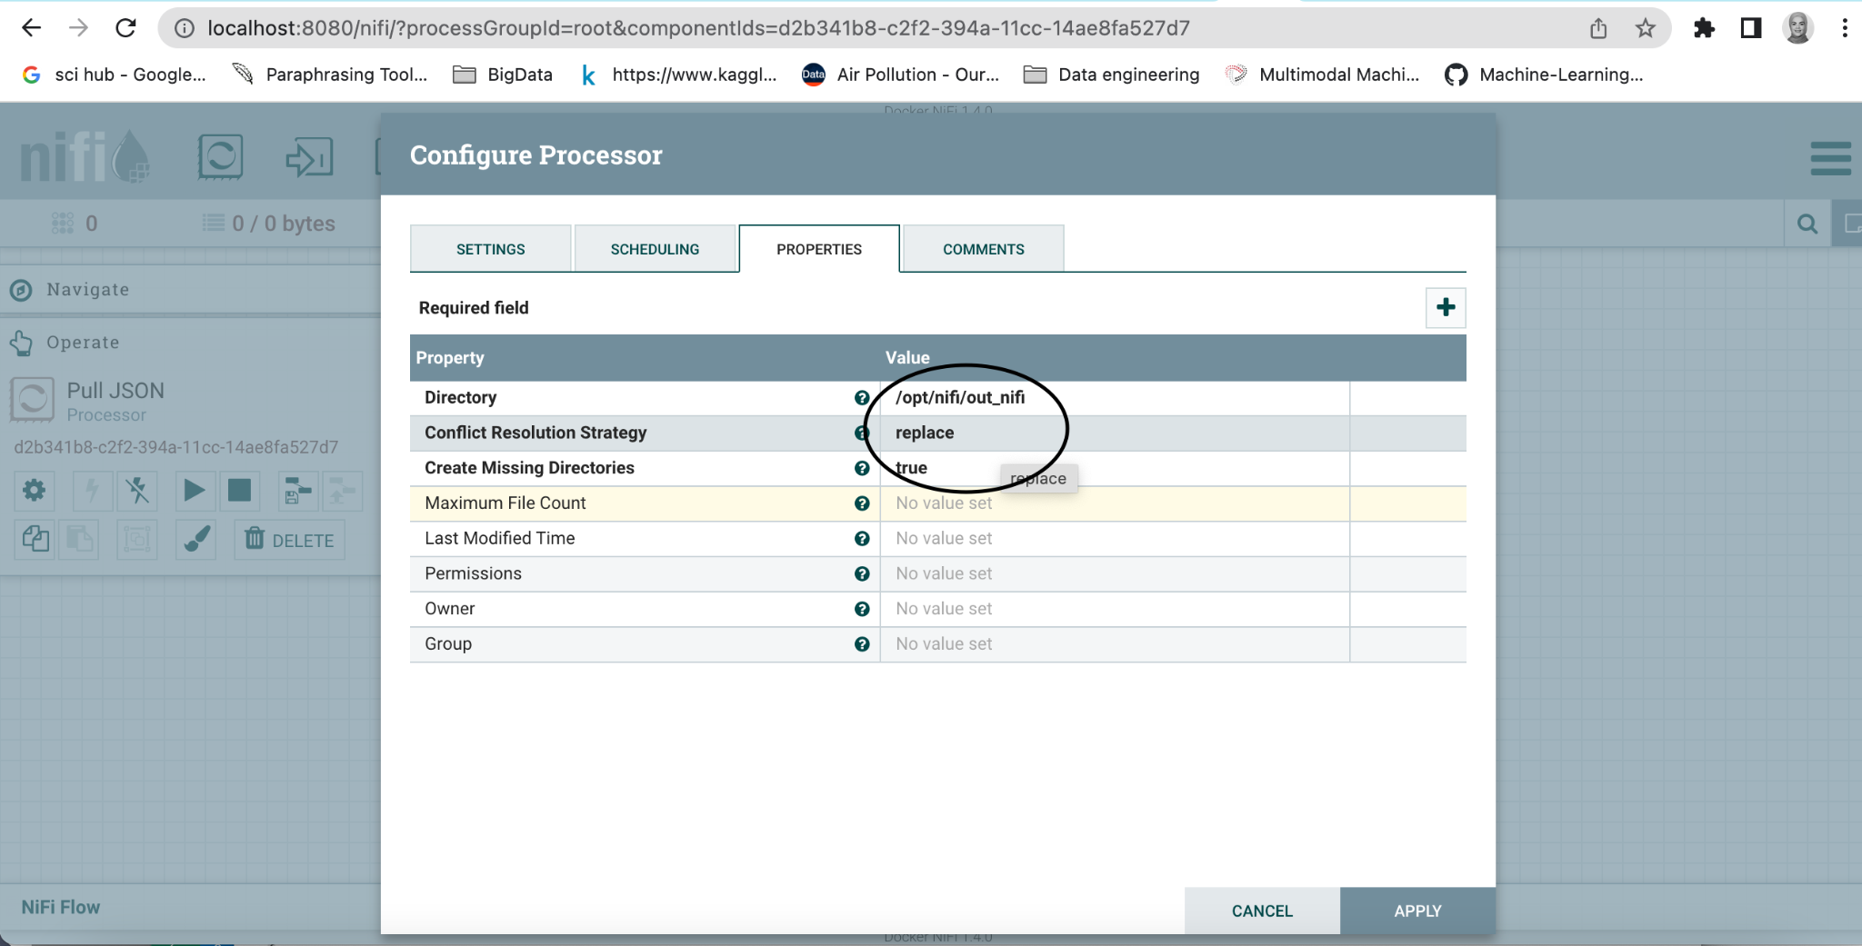
Set the json output file directory

Slide 12
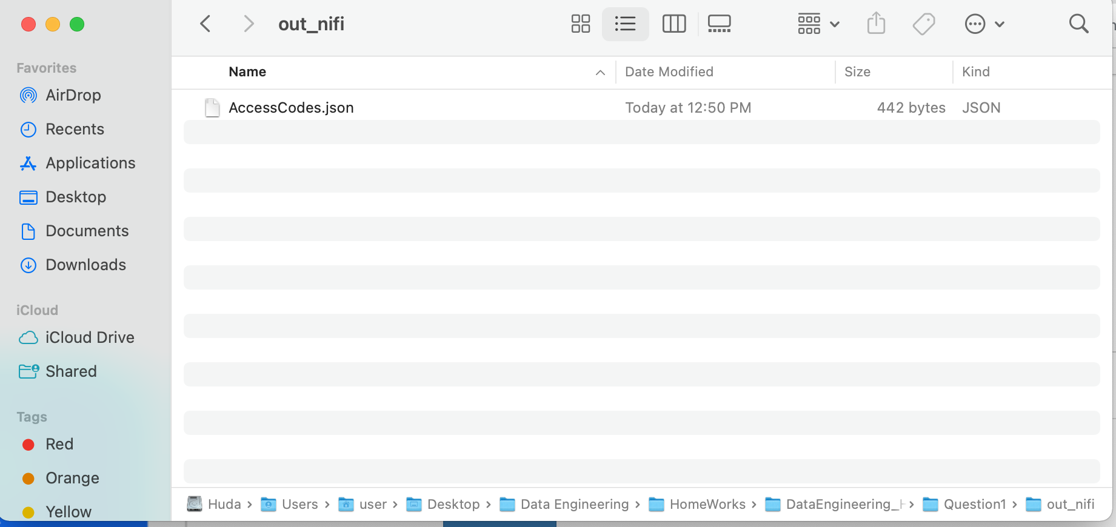
After running the workflow the json file will be saved

